Slide 1






Project
Protocol Protocol

Slide 2
Outline
The Team
What is a protocol?
Defining Our project
Website
Simulating
Topology Creation
Algorithms
Visualize
Organization
Milestones
Progress

Slide 3
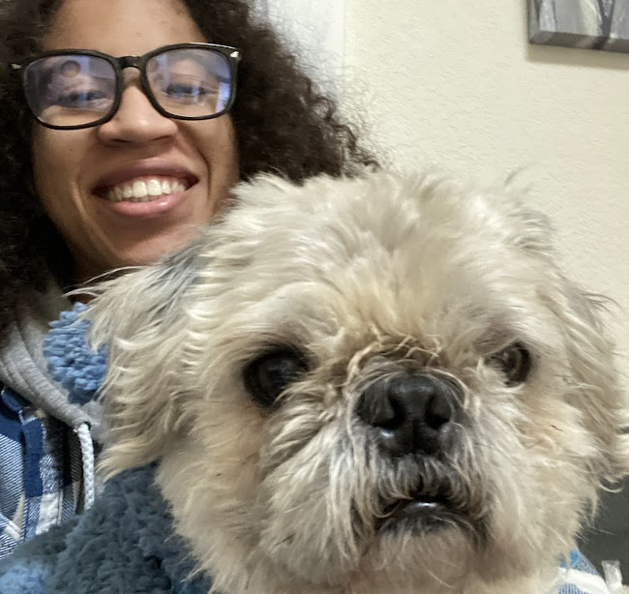


The Teammates
Matthew
Class: 2024
Major: Computer Science
<Name>
Class: <class year>
Major: <major>
<Name>
Class: <class year>
Major: <major>
<Name>
Class: <class year>
Major: <major>
Runbin Chen
Class: 2023
Major: Computer & System Engineering dual Computer Science

Slide 4
What is a Protocol?
A protocol is a system of rules that explain the correct conduct and procedures to be followed in formal situations. Aka how two systems communicate
Protocols you may have heard of before:
(HTTP) Hypertext Transfer Protocol
(IP) Internet Protocol
(TCP) Transmission Control Protocol

Slide 5
A single solution to an infinite amount of problems.” - Dr. Malik (A definition of an algorithm from Intro to Algorithms)

Slide 6
Project Description
The project has two main two components
Website
Simulator
The project protocol protocol is designed to provide a clear way to learn about protocols, through documentation (a website) and visual tools (simulator). This project provides a central

Slide 7
1. The Website
For Business Plans, Marketing Plans, Project Proposals, Lessons, etc

Slide 8
The Website
For this project, we had to design a website to showcase information for multiple different protocols from electronics, to networks, and more.
Technologies:
Reactjs
React Router-DOM
Sass

Slide 9
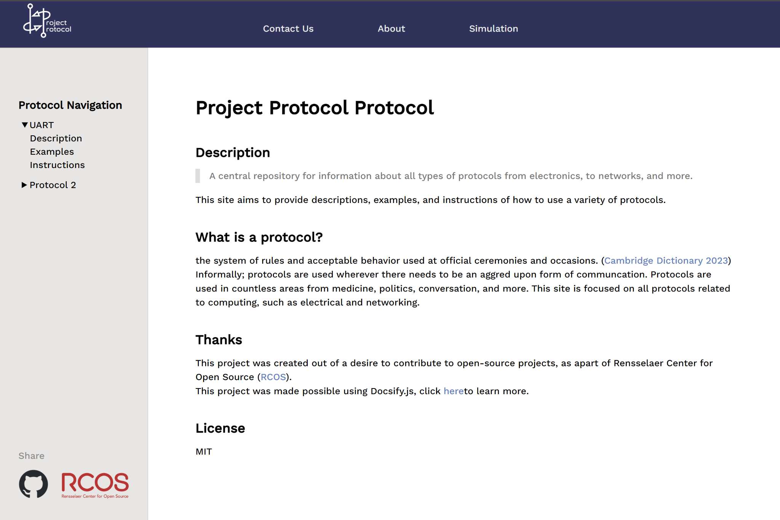
Main Page
We designed a sidebar to navigate different articles,
A navbar to put the logo and link to information about the project and site

Slide 10
Technologies

Slide 11
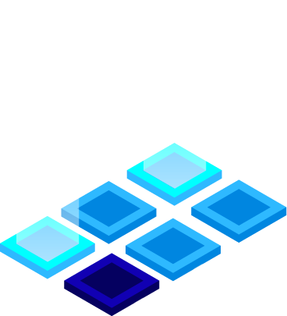
2.
The Simulation
Let’s start with the first set of slides

Slide 12
Parts of the Simulator
Topology Creation
Simulating
Visualizing
Each component was isolated into a separate program, with data being shared through a standardized format (also considered protocols)
Topology Design
Export topology
Run Simulation
Export Simulation data
Animate Simulation
Output Gif

Slide 13

Topology Design
Topology: The way a network is arranged
How devices and wires are set up to related to each other
Libraries used:
NetworkX
Pyvis
Notes:
Topology: The way a network is arranged
The way how devices and wires are set up to relate to each other
Reasons of introducing topology to our project

Slide 14
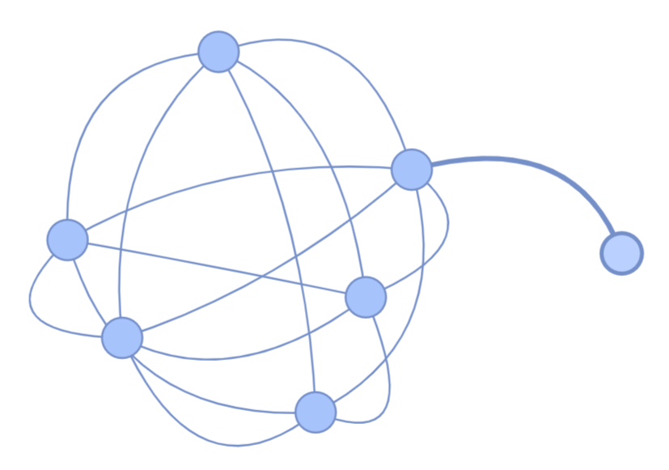
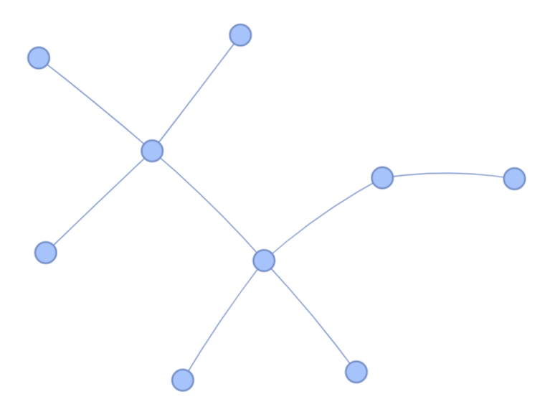
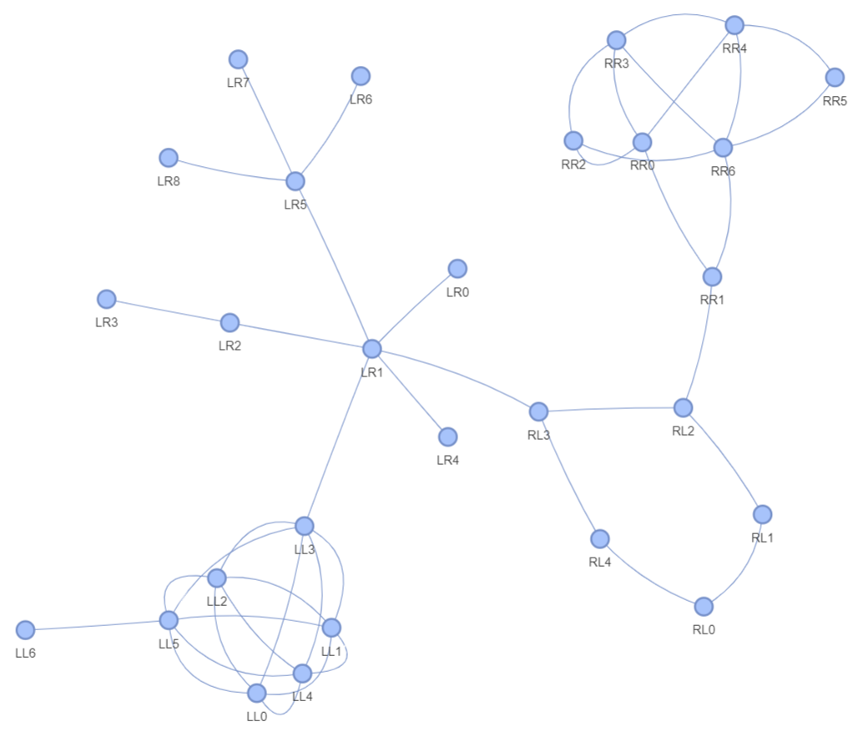
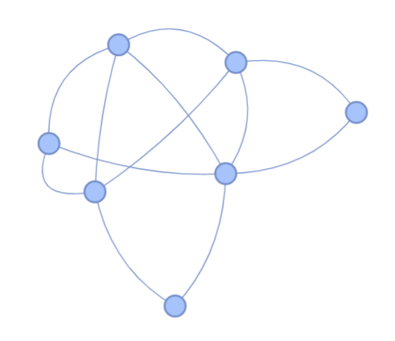
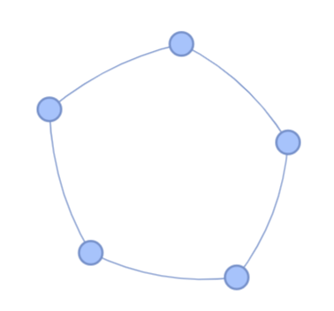
Topology Design
Merge these simple graphs we can get →
Notes:
Topology: The way a network is arranged
The way how devices and wires are set up to relate to each other

Slide 15
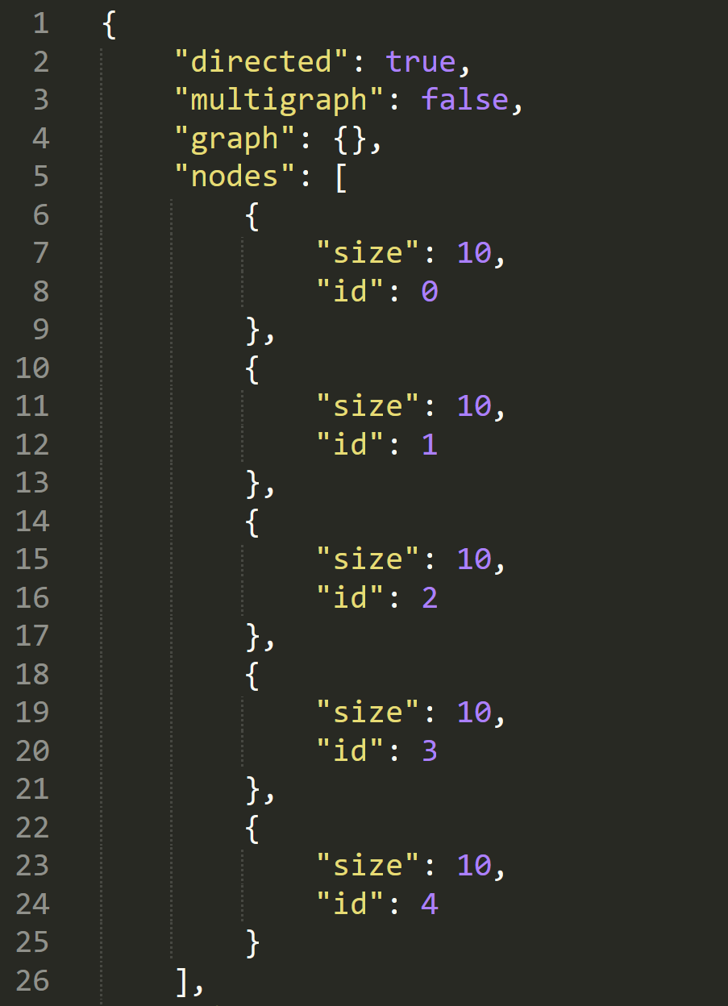
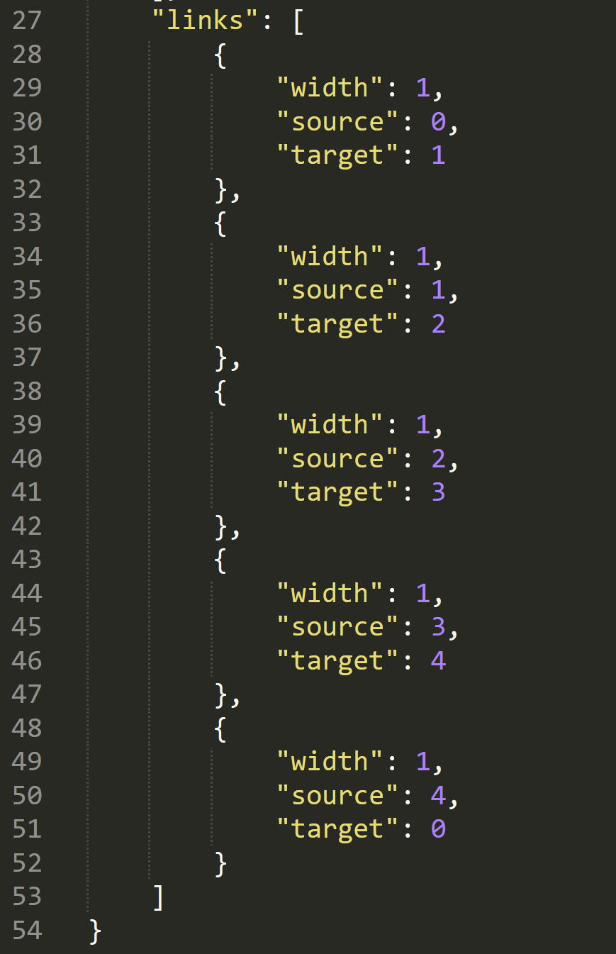
Topology Format
data.json
Notes:
Explain topology format here (bullet points?) - it’s better to expand on this while talking instead of having them read
Add photo of topology exporting format here

Slide 16
Simulating
Exporting usable data
Initial configuration
Simulation configuration
Simulation
Processing send/receive data
Events
Starting at a locale
Device
Wire
Device
Wire
Device

Slide 17
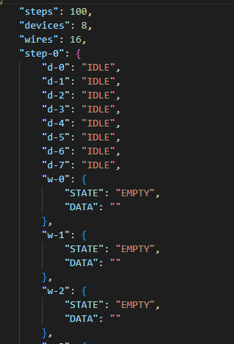
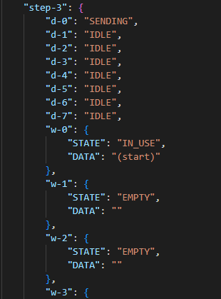
Simulation output Format

Slide 18
Visualizing
Using the previous two formats of topology (layout of devices and connections) & simulation (design of matrix)

Slide 19
Results
Collage of simulation output

Slide 20

3.
How it’s done
Let’s start with the first set of slides

Slide 21
Project Organization
Git Branch
Communication
File Organization
Protocol Protocol
Website
Simulation
Simulator
Visualizer
Separate coding environments
Both Discord and class time to work on project as well as assign milestones
Website, Simulation and Visualization in different folders for ease of access

Slide 22
Goals -> Progress
Create Interesting and engaging interface for simulation code
Website displays interface for the simulation
Create clear definitions and instructions for each protocol
Website displays markdown files that define protocols
Create clear examples that are portable
Simulations of defined protocols and outputs to visualizer
Have entries for at least 5 protocols
Halfway there !
Create basic simulation demo for at least 1 protocol
We have a way to simulation multiple protocols with dynamic entries

Slide 23
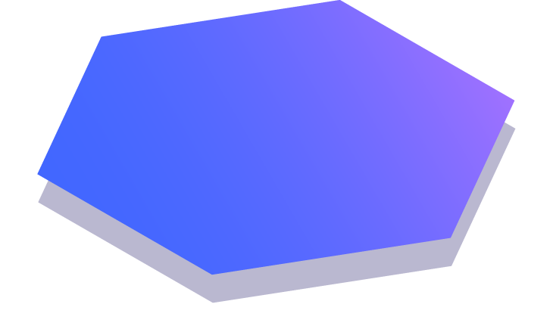
Thanks!
Any questions?
You can find me at:
@username
user@mail.me

Slide 24








Extra resources

Slide 25
SlidesCarnival icons are editable shapes. This means that you can:
Resize them without losing quality.
Change fill color and opacity.
Change line color, width and style.
Isn’t that nice? :) Examples:
Find more icons at slidescarnival.com/extra-free-resources-icons-and-maps

Slide 26
Diagrams and infographics

Slide 27
You can also use any emoji as an icon! And of course it resizes without losing quality. How? Follow Google instructions https://twitter.com/googledocs/status/730087240156643328
✋👆👉👍👤👦👧👨👩👪💃🏃💑❤😂😉😋😒😭👶😸🐟🍒🍔💣📌📖🔨🎃🎈🎨🏈🏰🌏🔌🔑 and many more...

